Slide 1
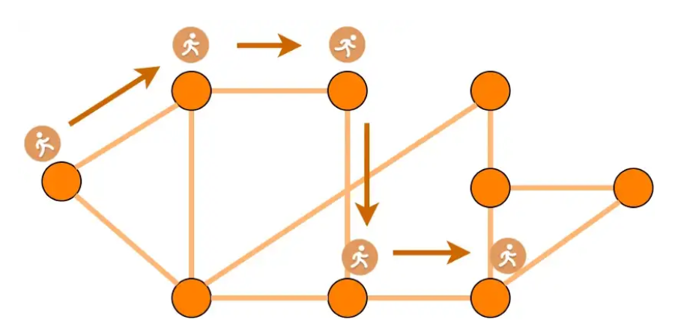
netGAN- Generating Graphs via Random Walks
By: Liraz Akiva, Amit Benita and Sahar Shomer Hay

Slide 2
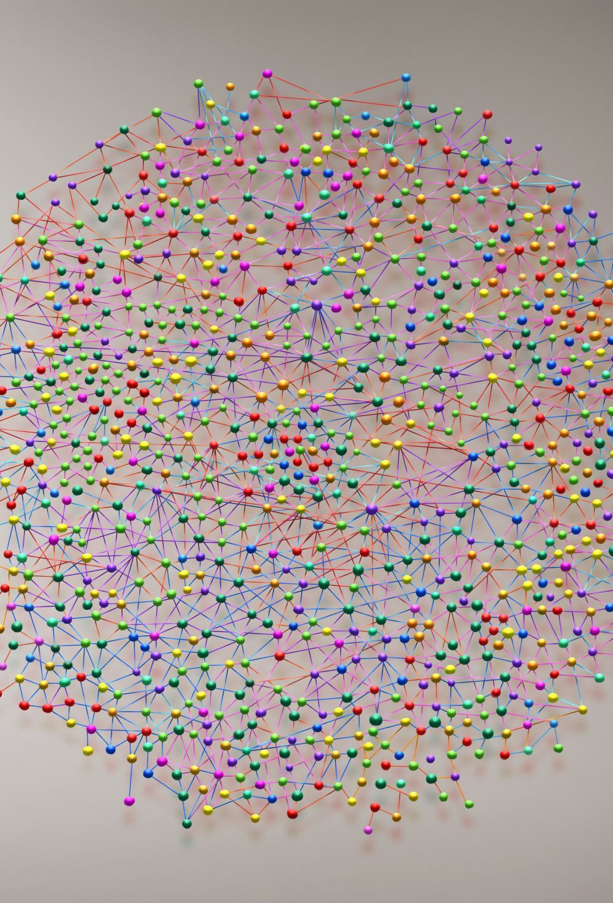
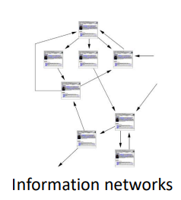
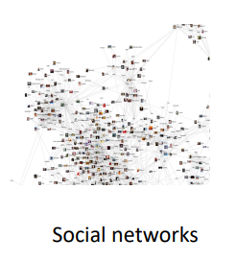
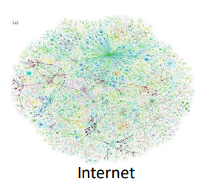
Generative Models for Graphs
Today graphs represent many structures of complex networks that are built in similar patterns:
Social networks
Information networks
Internet

Slide 3
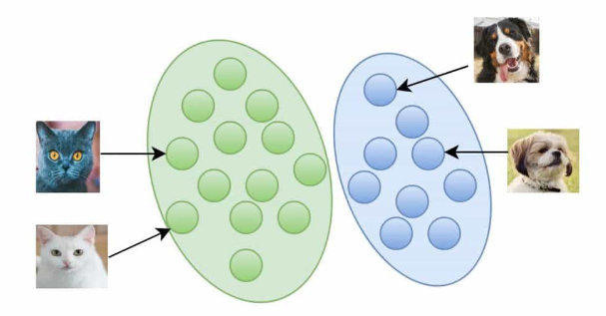
Generative Models for graphs
Learning about the input distribution.
Ability to create new samples.
A good generative model is a model that knows how to capture the characteristics of the graph in the real world.
GANs
GAN is a generative model for machine learning.
Uses a training set to learn about the model.

Slide 4
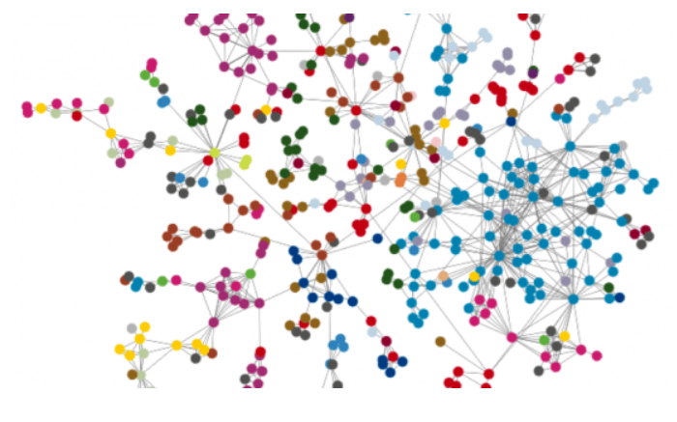

Challenges
We want to learn from a single large graph, thus we have only one training set.
Models are not trained to learn the topological structure of the graph.
The GAN architecture is limited by the size of the graph it can learn from.

Slide 5


NetGAN Idea
Learning to generate graphs by learning a distribution over random walks
Learn the topological structure of the graph.

Slide 6
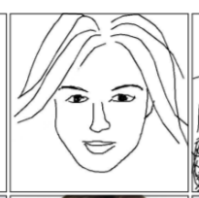
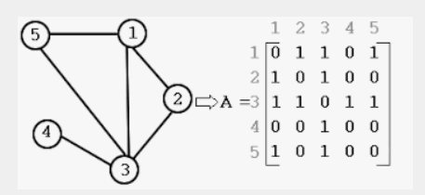
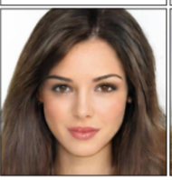
How netGAN work?
NetGAN receives a binary adjacency matrix of size NXN whose content resembles a graph.
The model goes over the matrix using random steps for that matter.
Number of walks is of length T and builds a set that will be the set on which we will base our model.

Slide 7
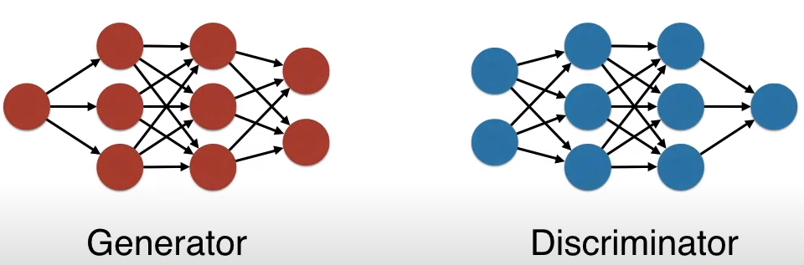
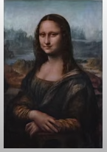
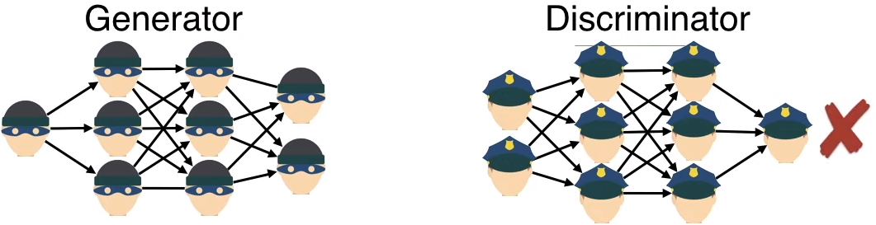
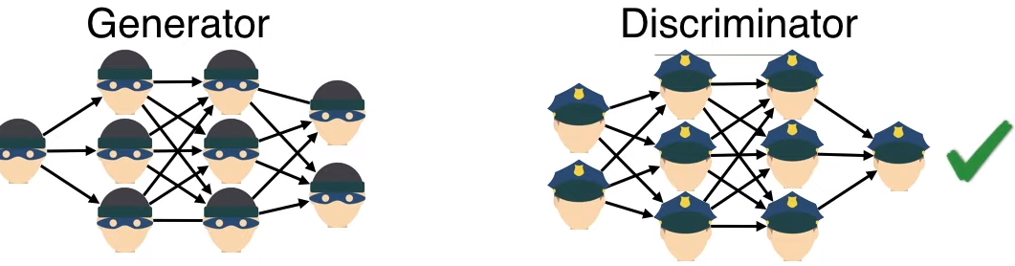
Intro: The GAN architecture
GAN- Generative Adversarial Network
Handle unsupervised data.
Human supervision is not needed.

Slide 8
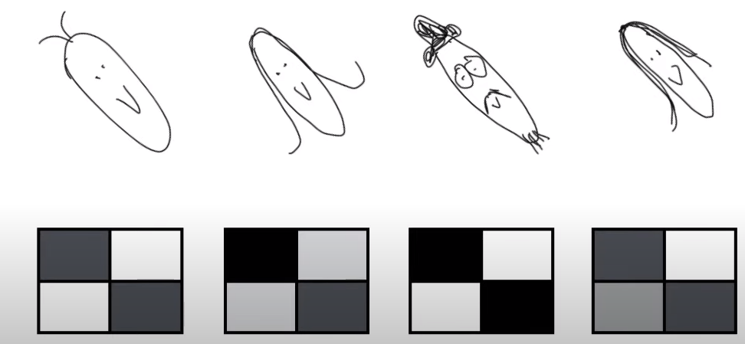
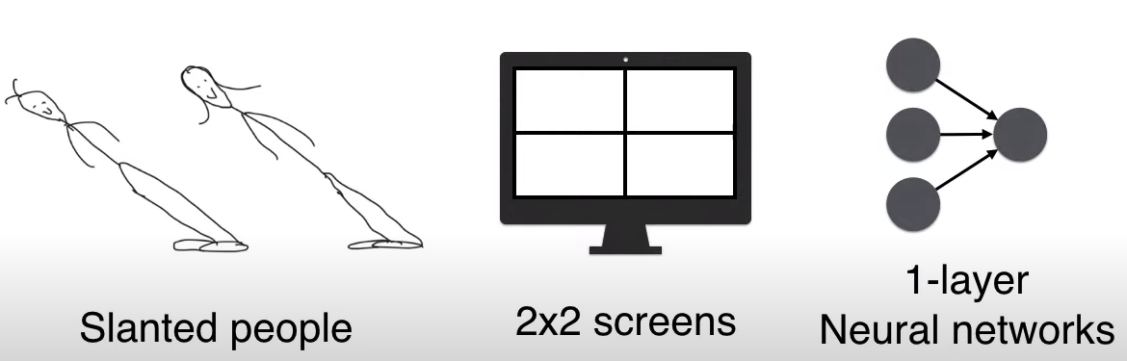
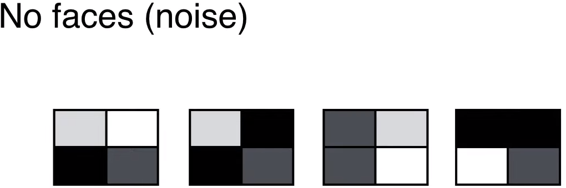
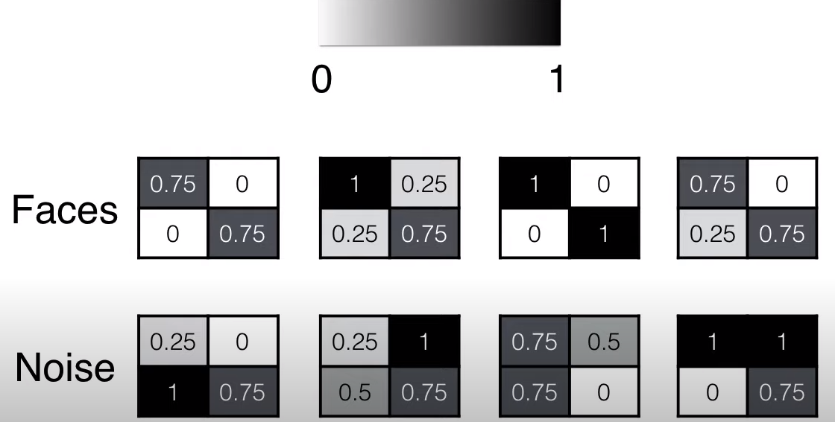
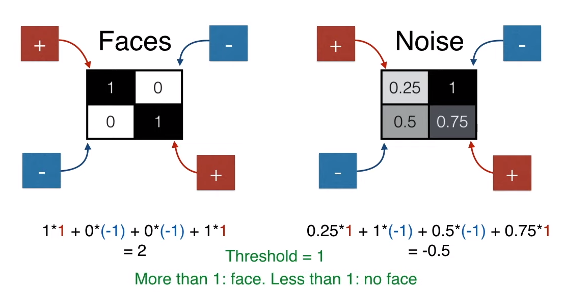
Example: Real vs. Fake
Real
Fake

Slide 9
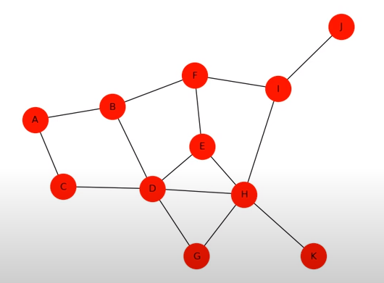
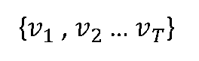
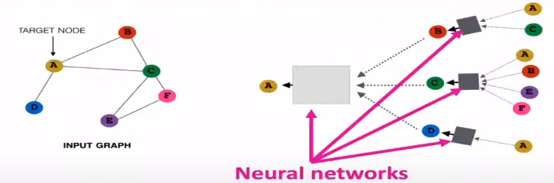
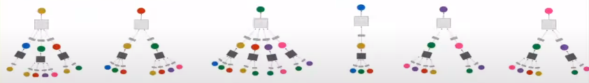
NetGAN
A random walk
Learns the distribution of random walks of the input graph.
Each node becomes a computation graph, based on its neighbors and defines its own neural network.
Creates general different graphs that are similar to the input graph’s topology.
Random walks (by. Jure Leskovec)
Real
Fake

Slide 10
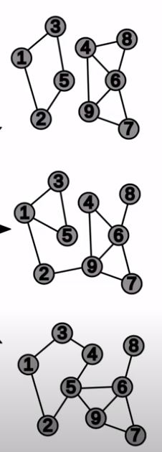
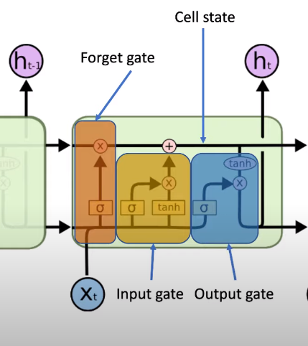
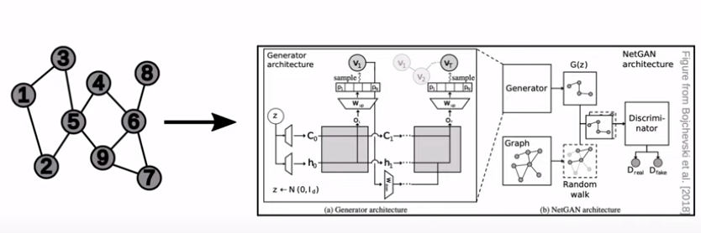
General intro
Input graph with N nodes is presented as an adjacency matrix Anxn, E {0,1}
In each step, 2 parameters are given: probability for the next node and the memory state.
When done processing a whole random walk, presented as a vector of T nodes, D outputs a final probability of that random walk being real.

Slide 11
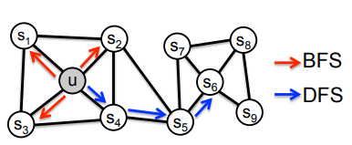
Random walks (leskovec node2vec)
Capturing the structure
Borrowing feature information
Considering the search strategies:
BFS- only immediate neighbors
DFS- sequentially sampled at increasing distances- depth
Why random?
Random walks are computationally efficient in terms of both space and time requirements
Exploring “neighborhoods” which define the network’s topology

Slide 12
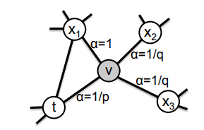
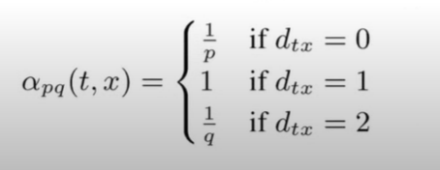
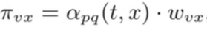
Random walks (leskovec node2vec)
Parameters p, q:
p controls the likelihood of immediately revisiting a node in the walk.
mediately revisiting a node in the walk. Setting it to a high value (> max(q, 1)) ensures that we are less likely to sample an already visited node in the following two steps (unless the next node in the walk had no other neighbor)
q allows the search to differentiate between “inward” and “outward” nodes.
if q > 1, the random walk is biased towards nodes close to node t.
if q < 1, the walk is more inclined to visit nodes which are further away from the node t.

Slide 13
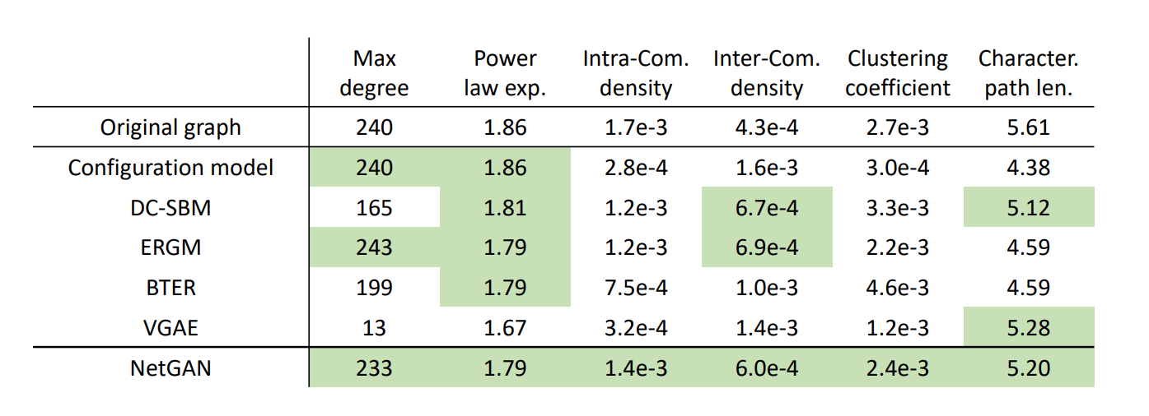
What can we do with NetGAN?
Generate graphs that have similar structure but are not replicas
Reproduce known patterns without manually specifying them.
The goal was to quantify the generalization power of the proposed model by evaluating its link prediction performance using feature change

Slide 14
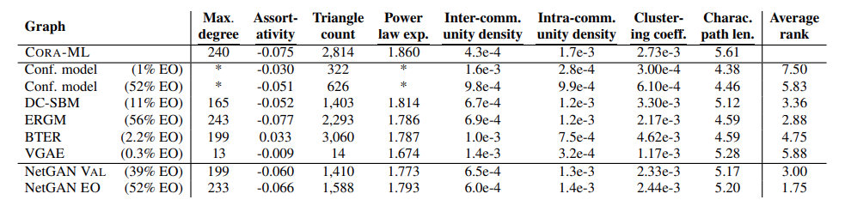
The results of creating an experiment 1 -Graph Generation
What do we do in experiments?
Create graphs to match NetGAN to a CORA-ML citation network (dataset) using CITESEER (a digital library that aims to collect and analyze data) in order to evaluate the quality of the graphs.
The results of the experiment:
The established models (which they used) excel in reproducing statistical data even if the characteristics are not explicitly stated in the model definition.
In the link retrieval task, NetGAN does work in preserving the features of the graphs.

Slide 15

But... there is a problem here
The input graph they tested in the previous experiment was similar to the resulting graph, so they performed another experiment in which they changed the overlapping edges between the input graph and the desired output in order to test the quality of the NetGAN algorithm.

Slide 16
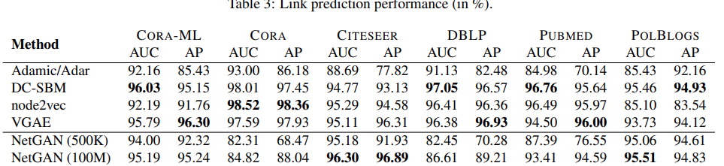
The results of creating an experiment 2- Link Prediction
The goal is to predict the existence of unobserved links in a given graph and evaluate the topographical generalization properties of NetGAN.
The results:
There is no overall dominant method with different methods for achieving good result.
NetGan shows competitive performance for all datasets and even advanced results unlike other algorithms.
Conclusions:
NetGAN performance increases when increasing the number of random walks in the graph.
For an additional computational cost, it is possible to achieve significant gains in the performance of connection prediction.

Slide 17
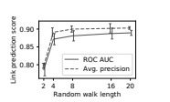
The length of the random walks T
The selected value is:
T = 16

Slide 18
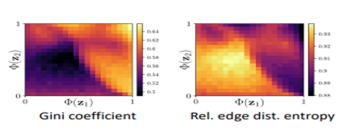
Interpolate between graphs
Latent space interpolation is a good way to get insight into what kind of structure the generator is capable of capturing.
To be able to visualize the characteristics of the graphs created we train our model and do it in small parts to understand what is happening in certain places.
Instead of sampling from the entire 2D latent space, sample from small sub-regions Each pixel in the plots corresponds to a graph (statistic) sampled from a sub-region.

Slide 19
Summary
NetGAN – Deep implicit model generating graphs via random walks captures known graph patterns without manually specifying them generalizes.
It has been shown to produce high-quality synthetic data for a variety of tasks, including generating images, text, and audio.
It can generate synthetic data in an "unsupervised" manner, meaning that it does not require labels or explicit guidance on what the synthetic data should look like. This can be useful in situations where it is difficult or expensive to obtain labeled training data.
Conclusions and additional results:
Fixed graph size Can only generate graphs of same size as the input.
Larger graphs need more random walks to get representative transition counts.

Slide 20


